Slide 1
AMERICANISM
ALSO KNOW AS AMERICAN PATRIOTISM
BY: MICHELLE BUTLER

Slide 2
DEFINITION
Americanism is a set of national values which aim to create a shared American identity for the United states.
“an articulation of the nation's rightful place in the world, a set of traditions, a political language, and a cultural style imbued with political meaning”
it can represent spirit of freedom pursuit of equality and one's dreams
it is a way of life that celebrates freedom, equality, and opportunity

Slide 3
VFW AUXILIARY FOUNDATION MEMBERSHIP
AMERCANISM CORE VALUES
Auxiliary Outreach
Buddy Poppy & National Home
Extension & Revitalization
Historian & Media
Hospital
Legislative
Scholarships & Youth
Veterans & Family
President’s Special Project

Slide 4
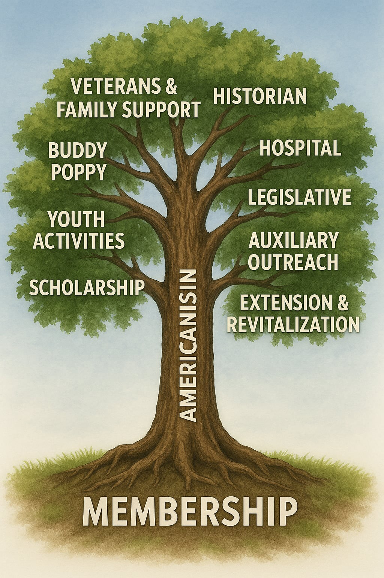

Slide 5
Ways we can show Americanism and Patriotism
RESPECT FOR OUR FLAG
RESPECTING EACH OTHER
THROUGH TRADITIONS, WE KEEP THE SPIRIT ALIVE
TEACH OUR CHILDREN, THEY ARE OUR FUTURE
INSPIRE OUR COUMUNITY BY INCLUDING THEM, UNITY
REMEMBER, SUPPORT AND EDUCATE OUR MILITARY HOLIDAYS

Slide 6
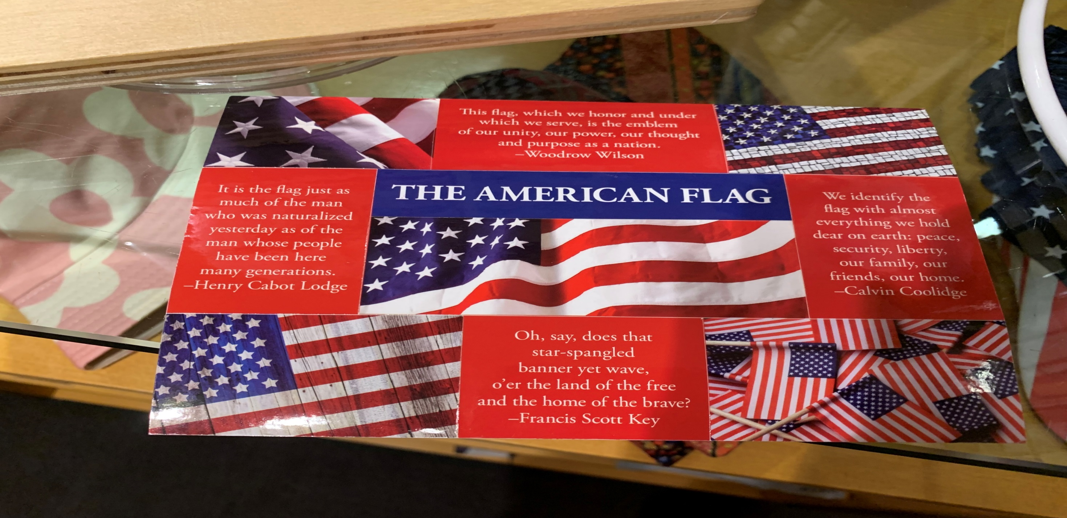
Our Flag is our Nations Symbol

Slide 7
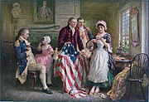
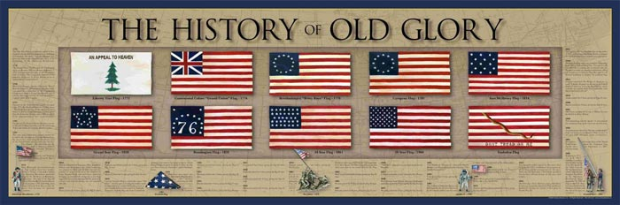
June 14, 1777
Flag Day
“ the Flag of 13 United States will be 13 stripes alternating Red & White
Union Of 13 Stars white in a blue field”
Unclear during the Revolution how many styles
This Photo by Unknown Author is licensed under CC BY-SA
This Photo by Unknown Author is licensed under CC BY-SA

Slide 8
Showing proper Respect to the Flag
•During our Ritualistic meeting, the President will say “Salute” when the Flags enter and leave the room, as well as when we say the Pledge of Allegiance and sing the National Anthem. Salute the Flag by placing the palm of the right hand flat over the heart.
•During Auxiliary meetings, the heart salute shall be used at all times where the salute is used.
•A member who is also a veteran may use the military salute.
•When the Flag is displayed AND the National Anthem is played and/or sung, all present should face the Flag and salute.
•When the Flag is NOT displayed and the National Anthem is played and/or sung, all present should face the music and salute.
•Members should stand when the Flags are moving.

Slide 9
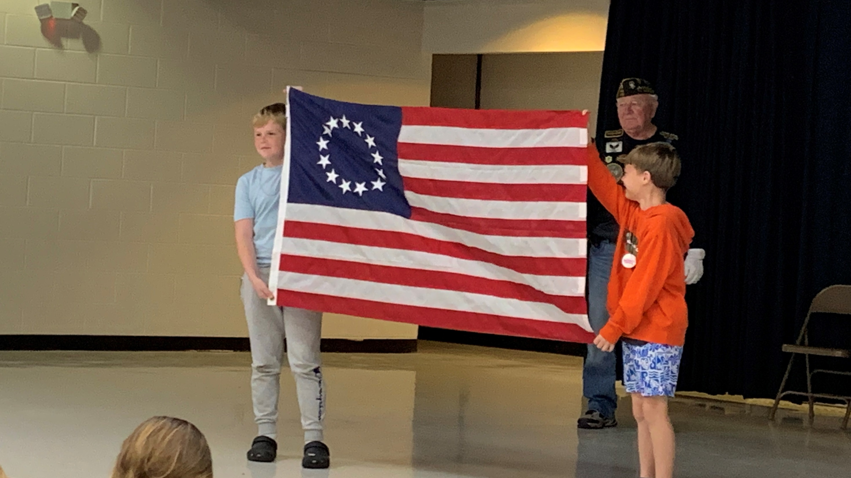
Educating Our children

Slide 10
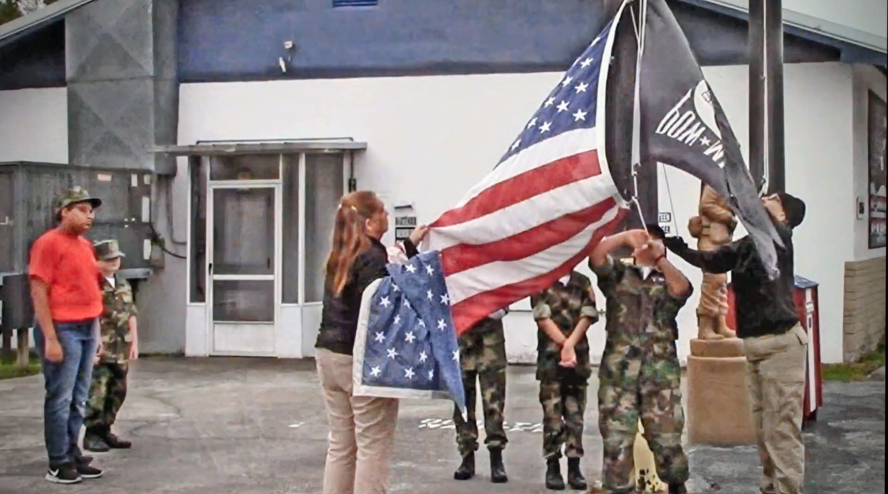

Slide 11
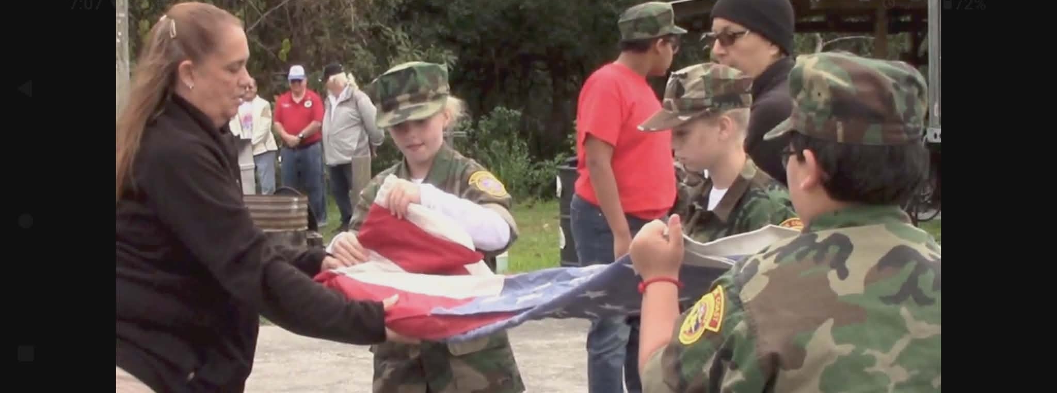
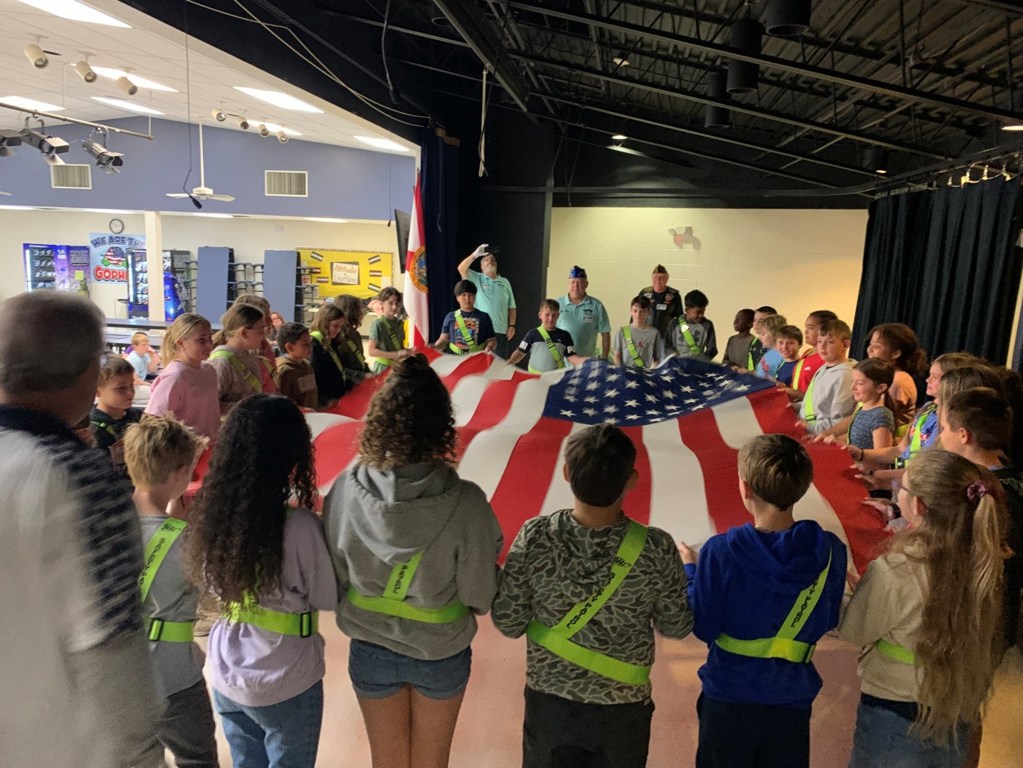
Folding

Slide 12
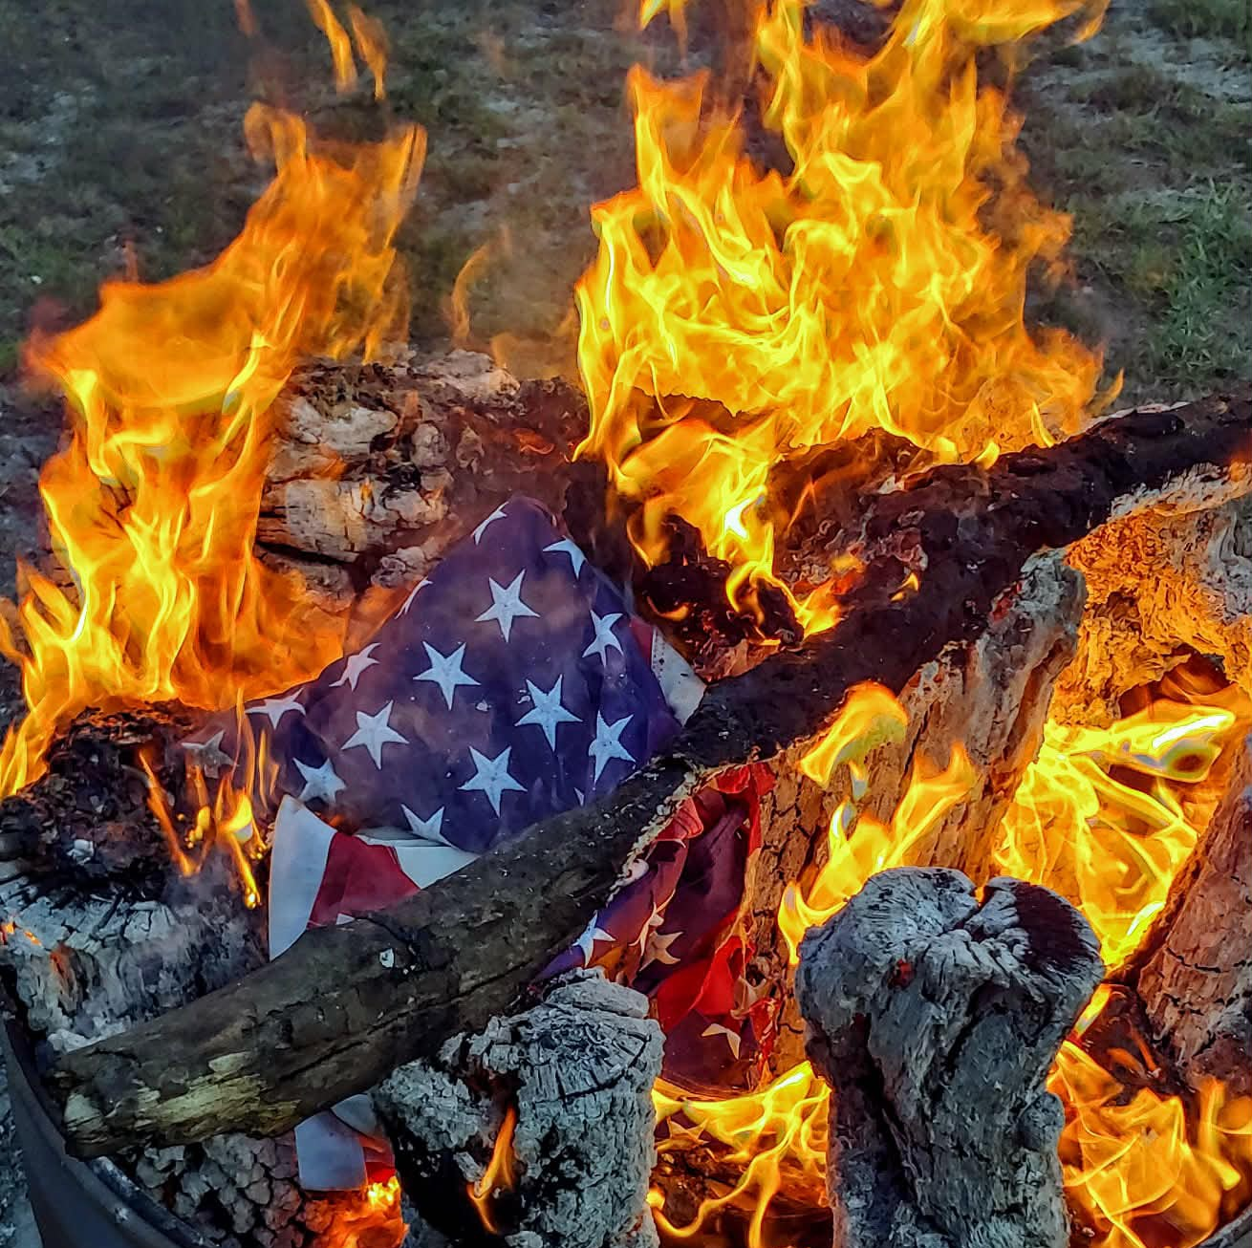
Proper Retiring of our Flag

Slide 13
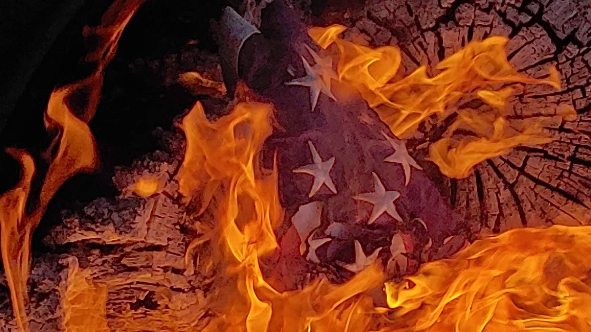

Slide 14
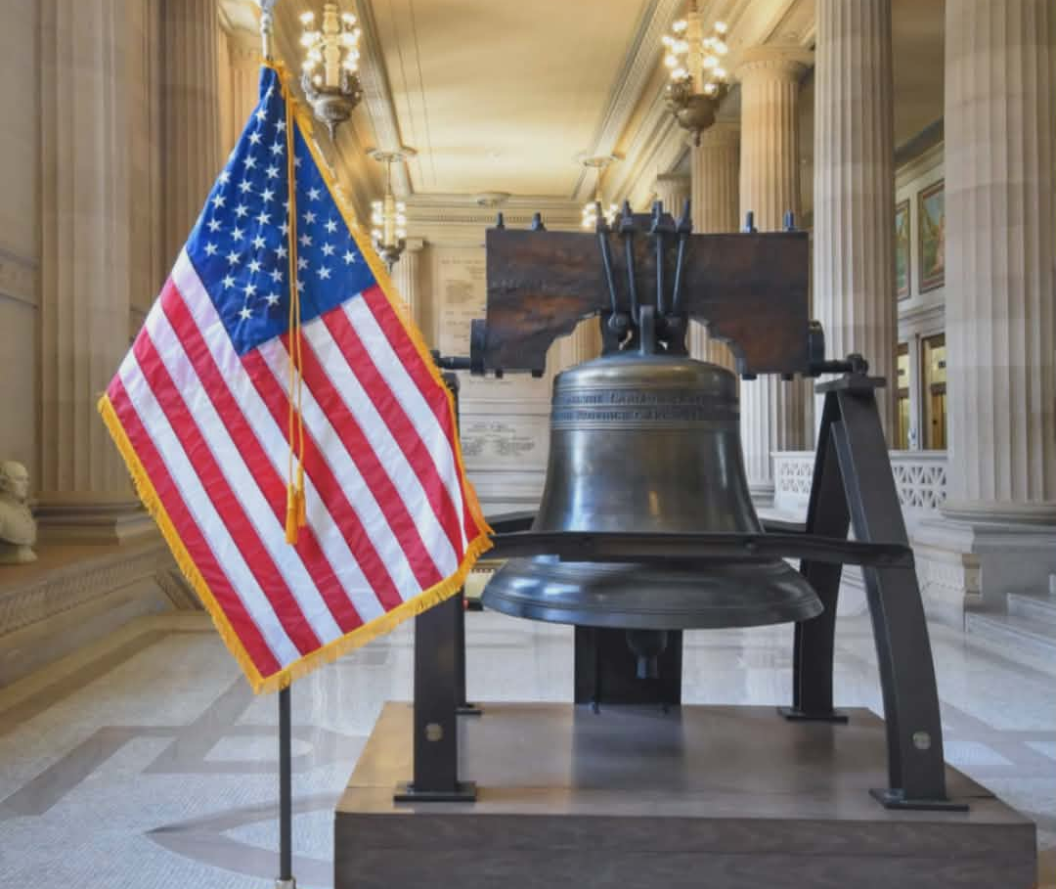
Celebrating
250 years strong

Slide 15
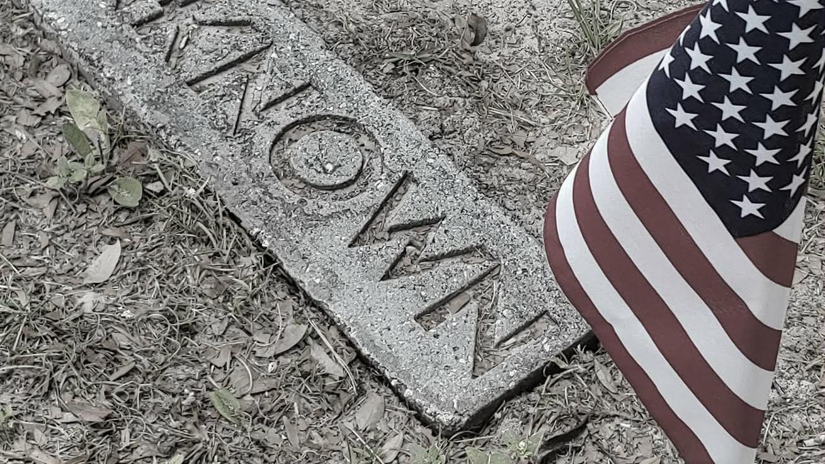

Slide 16
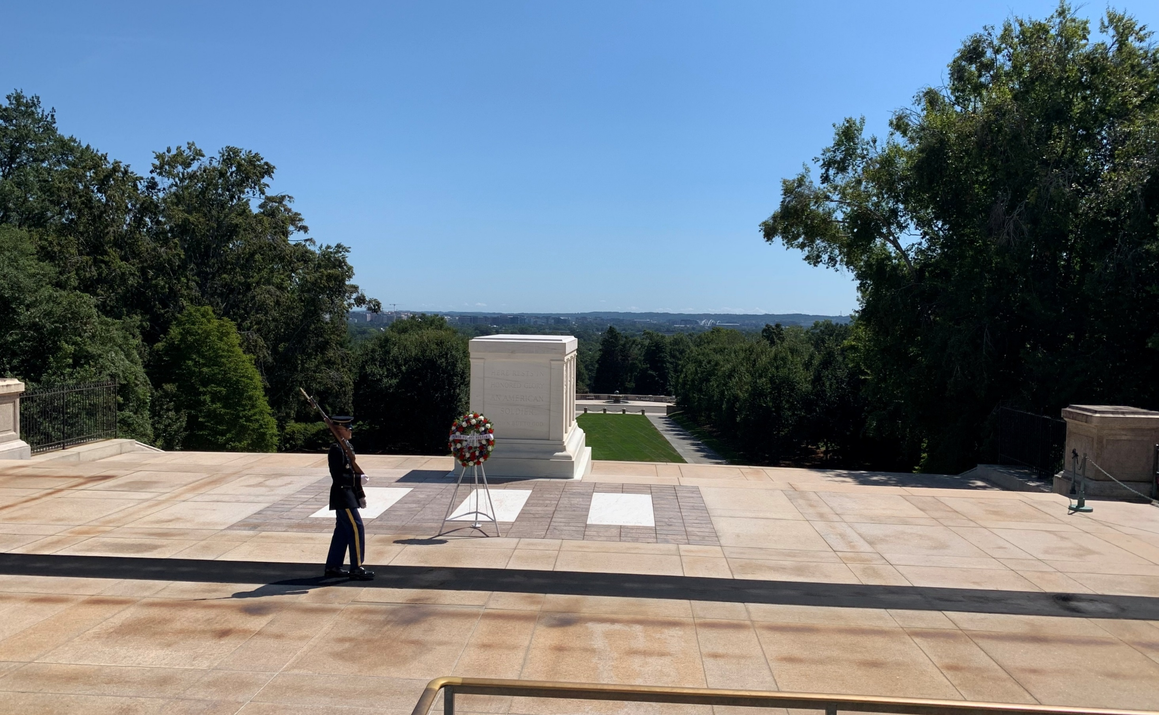

Slide 17

SMART/MAHER
VFW National Citizenship
Education
Teacher Program
Honoring those who help shape
Children for our Future

Slide 18

Gold Star Mother’s and
Family

Slide 19


Additional Star Flags
BLUE STAR SERVICE BANNER
SILVER STAR SERVICE BANNER

Slide 20

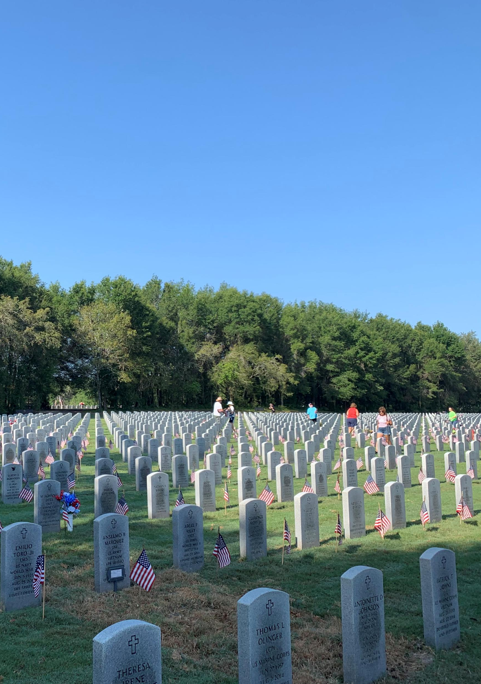
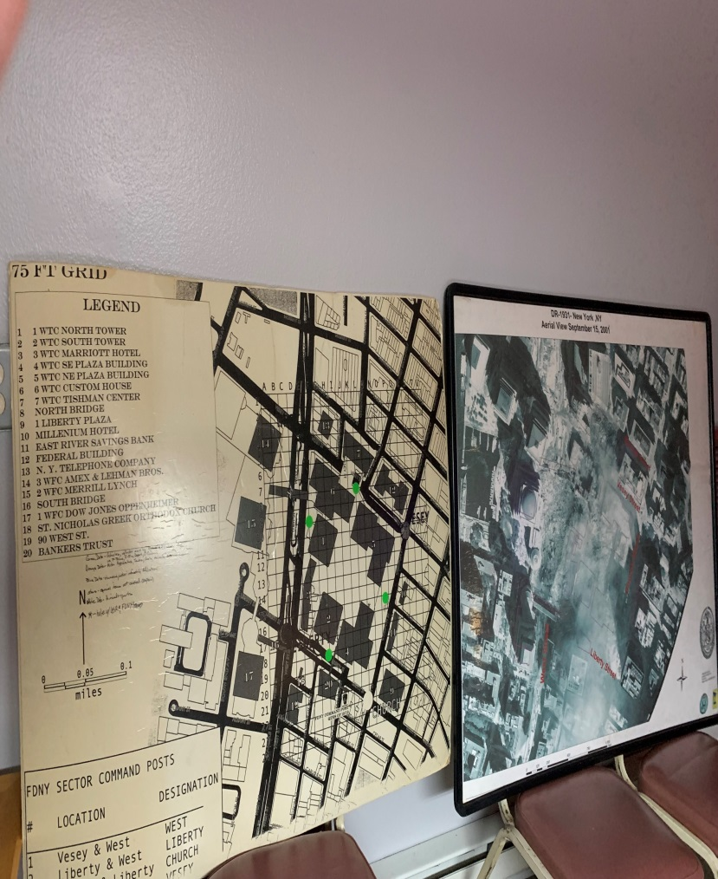
Remember and
Support OUR
Military and Service

Slide 21
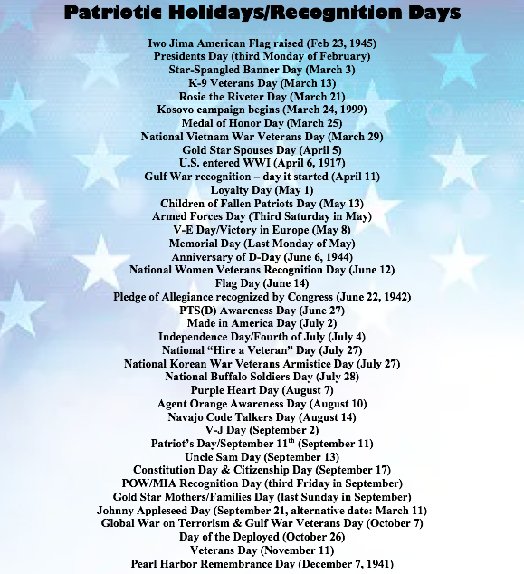
DATES TO REMEMBER

Slide 22

How do you say, Thank You!

Slide 23
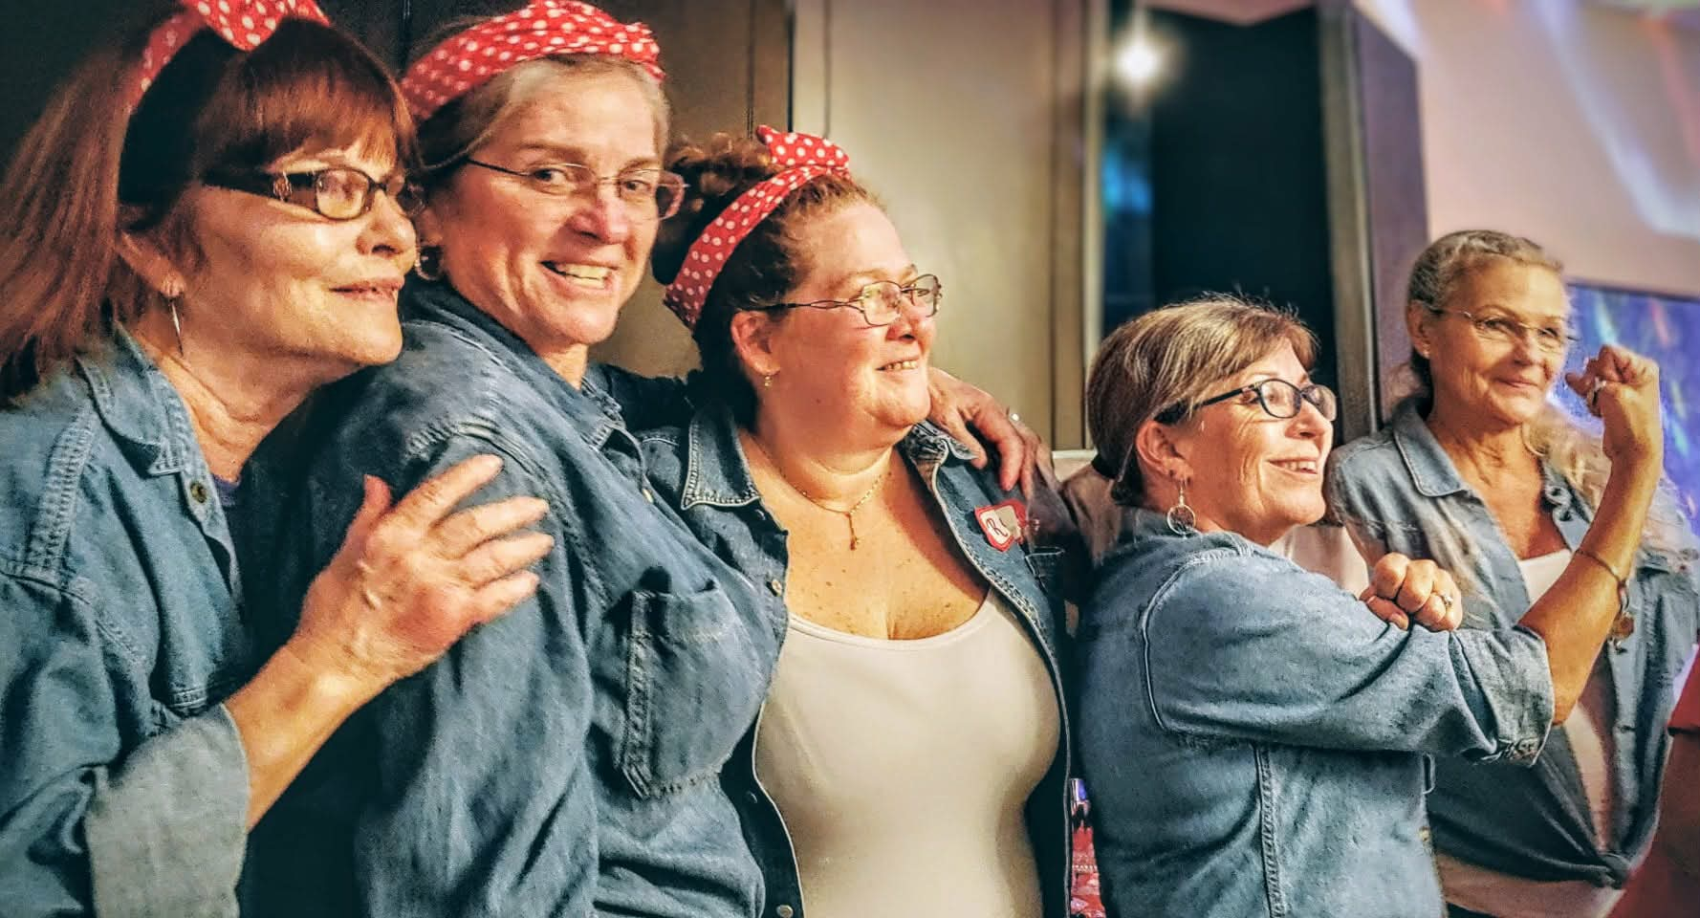
REPORT !!

Slide 24
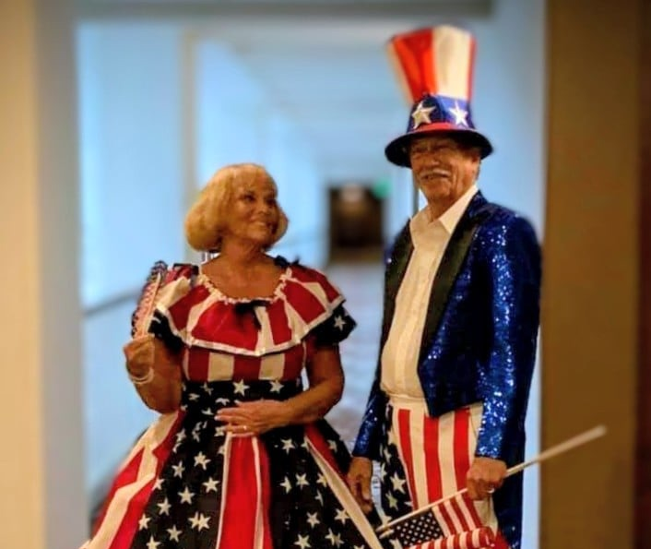
How do you show your colors and love for your country?

Slide 25
Think about it …
What does Americanism mean to YOU ?
Award Reports Due by March 31, 2026
All reports due April 15th

